Slide 1
Windows Server Container Glyphs
Created by Martin McClean.
Direct any questions, suggestions or alterations to mmcclean@microsoft.com

Slide 2
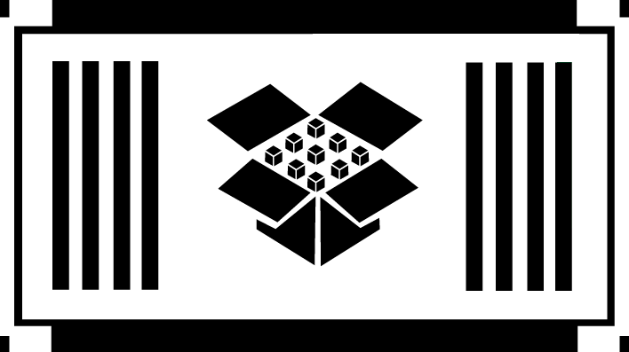
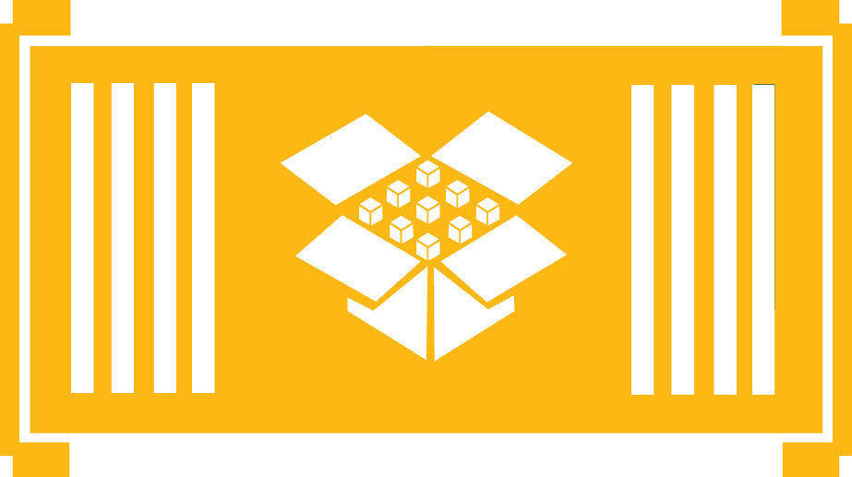

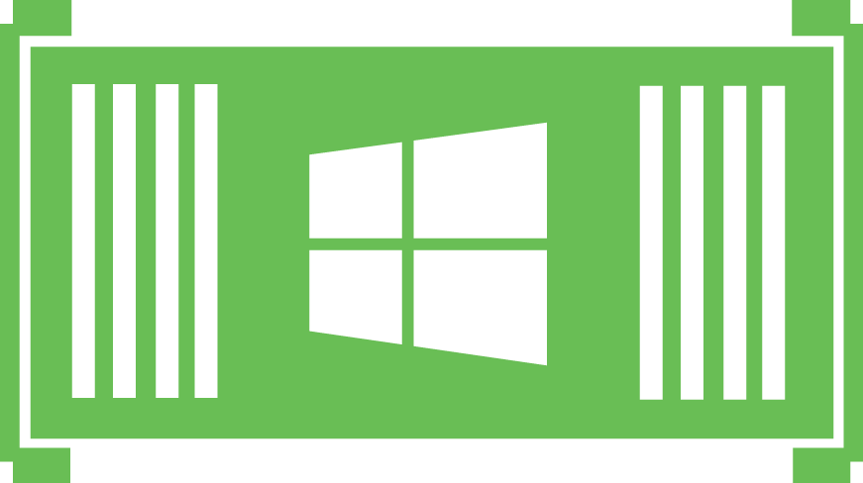
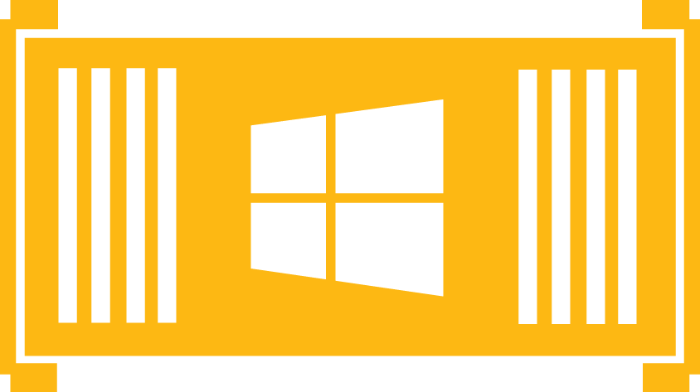



Windows Server Container Glyphs
App in Container
Windows Container
Linux Container

Slide 3

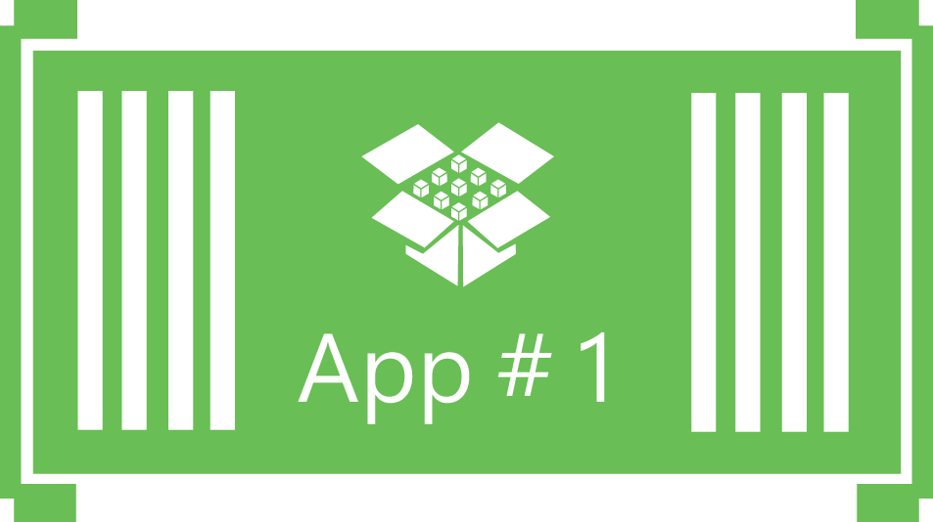
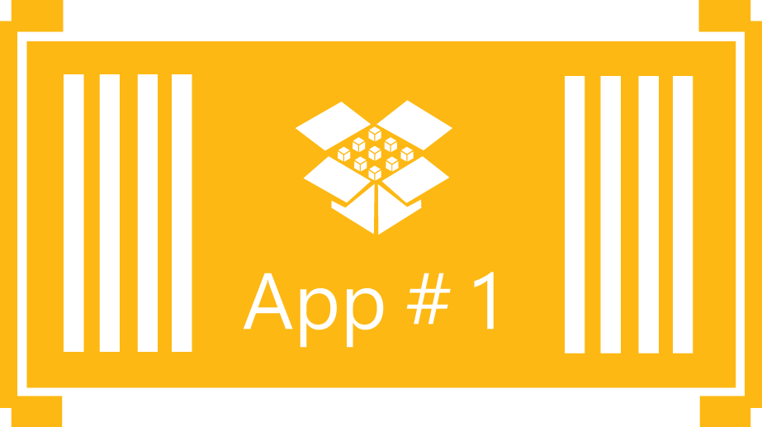


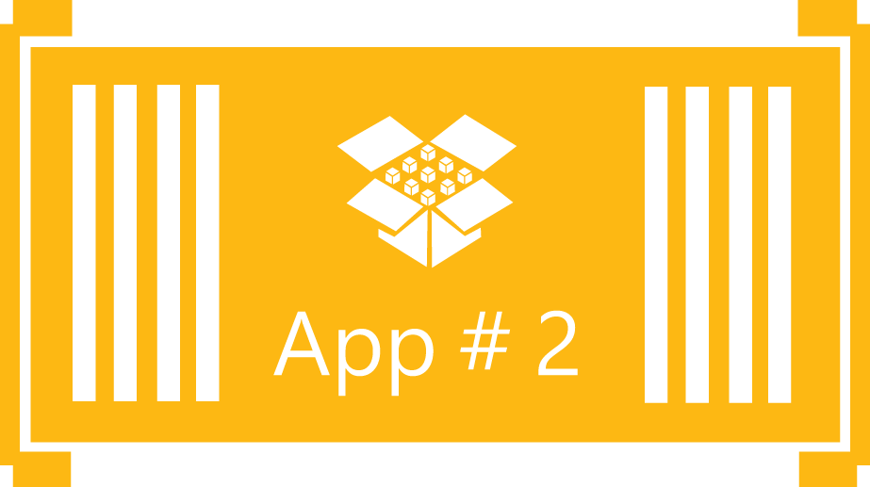
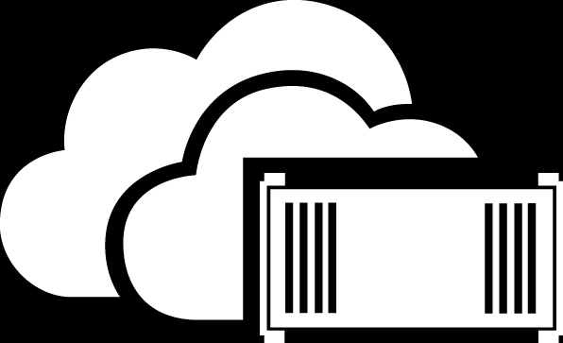


Windows Server Container Glyphs
Sample Apps Containers (#1)
Sample Apps Containers (#2)
Azure Container

Slide 4












Windows Server Container Glyphs
Virtual Machine (Choice #1)
Virtual Machine (Choice #2)
Virtual Machine (Choice #3)
Virtual Machine (with application installed)

Slide 5
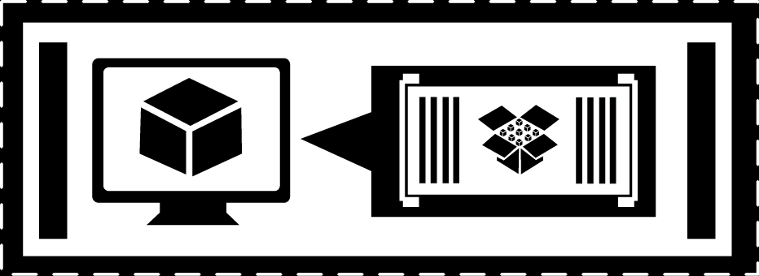
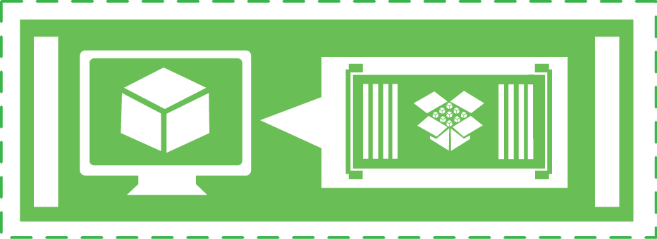
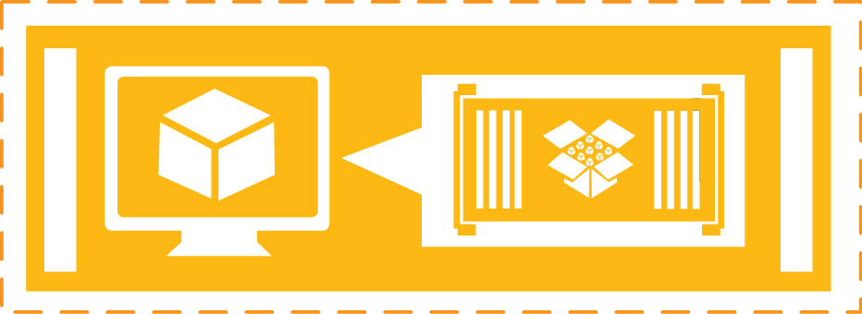

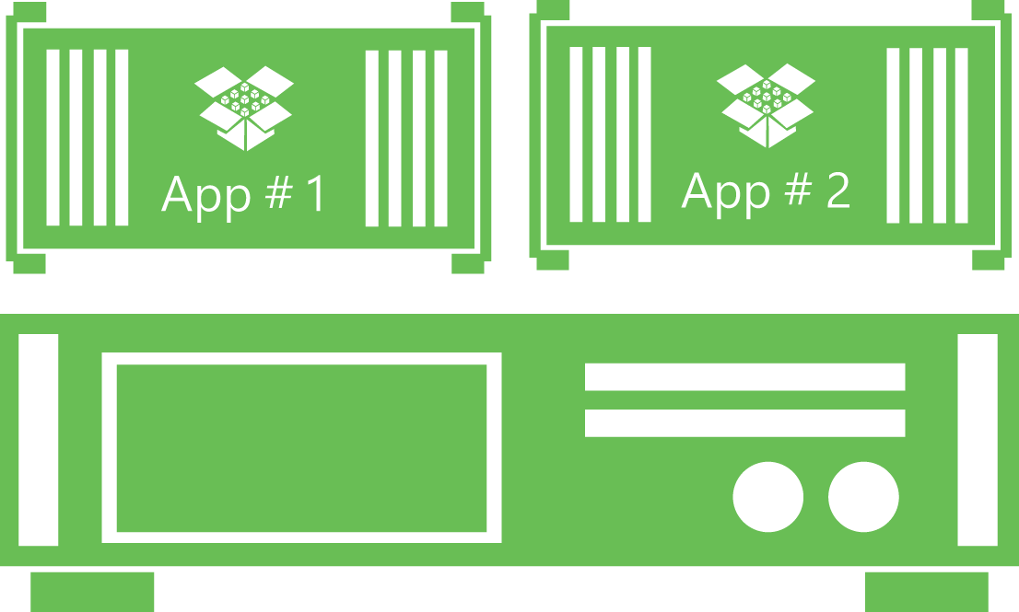
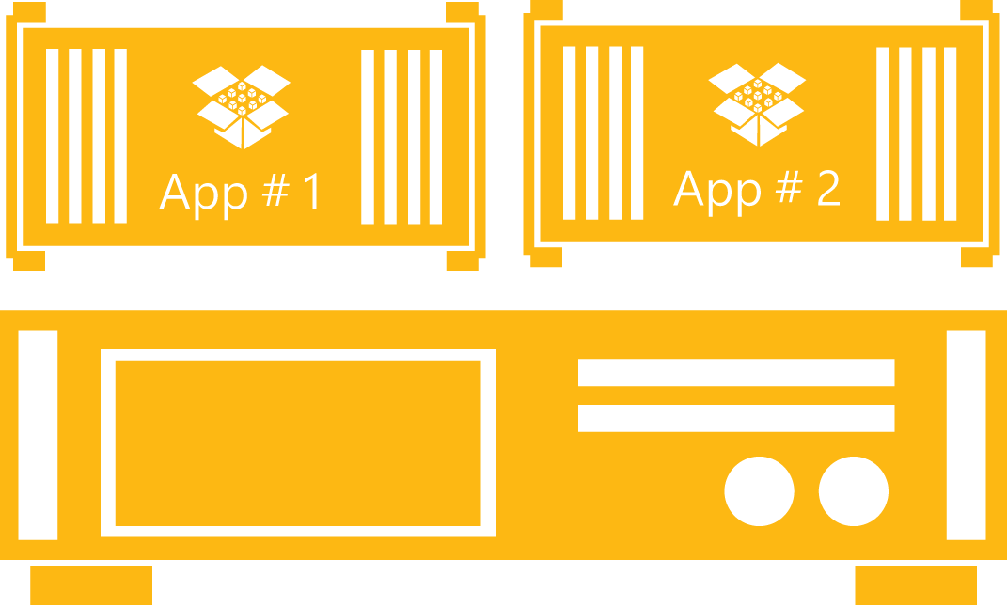






Windows Server Container Glyphs
Virtual Machine (with Container and App)
Physical Computer with Containers
Clouds
Applications

Slide 6
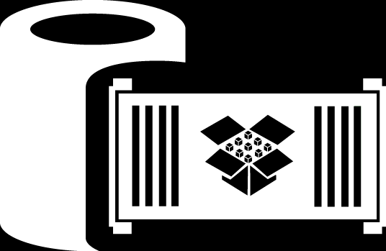
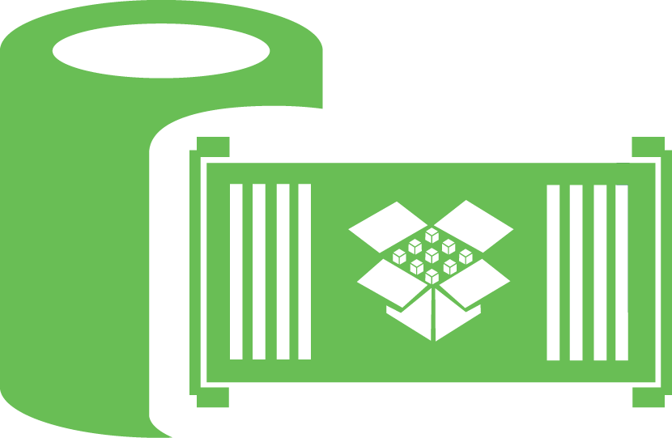
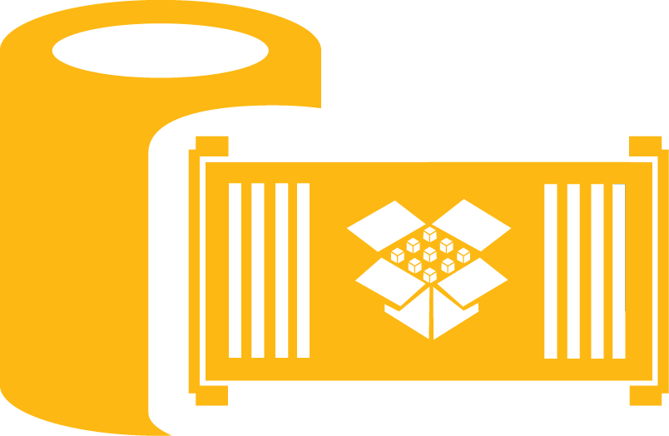
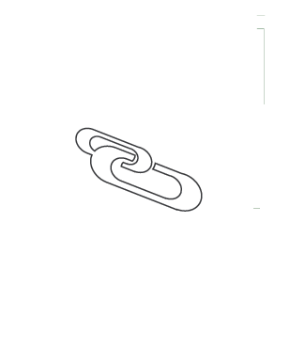
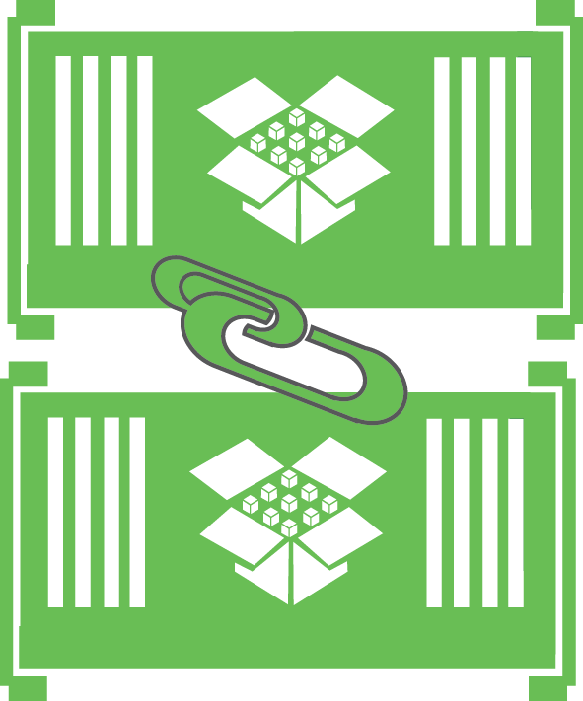
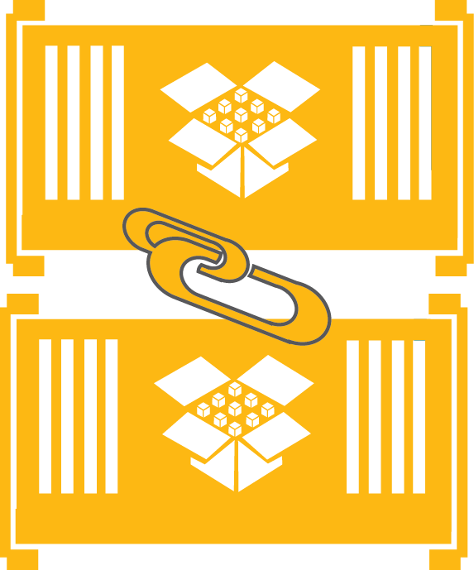

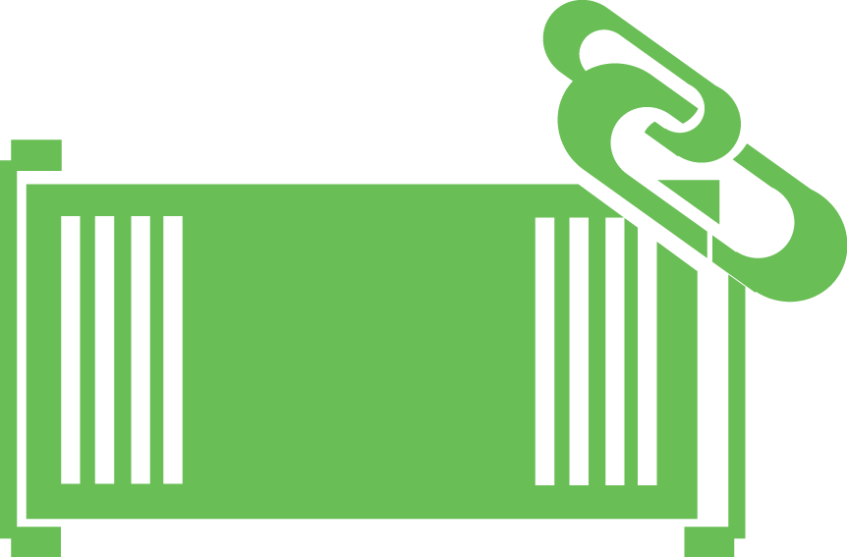

Windows Server Container Glyphs
Containers Storage
Linked Container (Choice #1)
Linked Container (Choice #2)

Slide 7









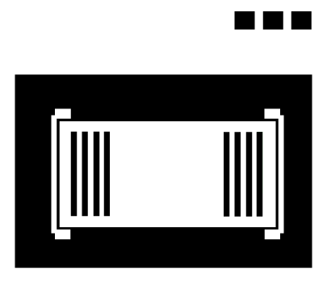

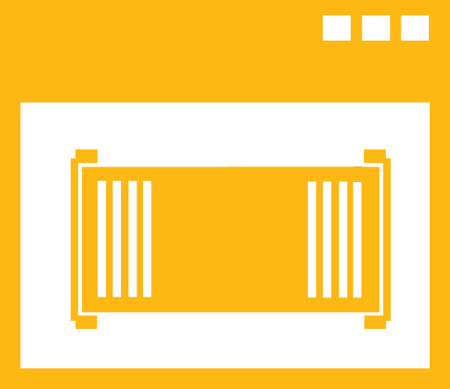
Windows Server Container Glyphs
Physical Computer/Server
Physical Computer /Server (with installed application)
Users / Developers
Container Management

